Slide 1
Hostel Management System
Paras ,Kapleshwar Kumar
B.tech CSE-6(B)
GU-2022-4270 , GU-2022-4287

Slide 2
Contents
Project Explanation
Advantages of project
DFDs
Technology used
Requirement
Screenshots
Conclusion
Future work

Slide 3
Project Explanation
The Hostel Management System is a web-based application developed using the MERN stack, with Vite and React powering the frontend for a fast and efficient development experience. This project is designed to streamline the management of hostel operations by providing separate interfaces for both admins and students. Admins can manage room allocations, maintain student records, handle complaints, and track payments, all through a centralized dashboard. Students, on the other hand, can log in to view their room details, submit complaints or feedback, and check their payment status. The backend is built using Node.js and Express.js to create robust RESTful APIs, while MongoDB serves as the database to store and manage data related to rooms, students, and transactions. Mongoose is used to interact with the database efficiently. For security, the system uses JWT for user authentication and Bcrypt for secure password hashing. Overall, the project offers a complete and efficient solution for hostel management, improving both administrative control and student convenience.

Slide 4
Advantages of project
Convenience
Real-Time Availability
Time Efficiency
Global Reach
Secure Transition
User Review and Rating
Secure Transaction
Customer Support

Slide 5
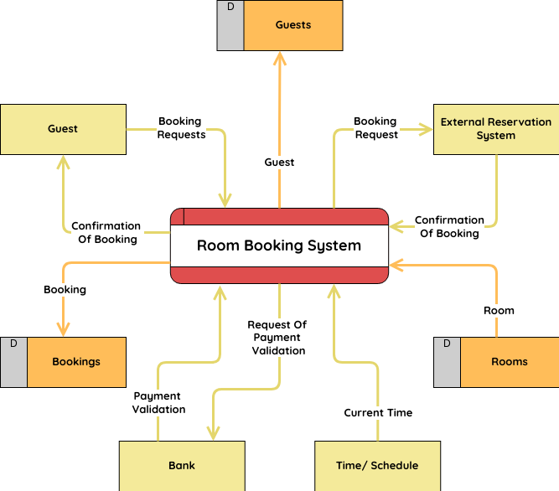
DFDs

Slide 6
Technology Used
HTML
CSS
BOOTSTRAP
JAVASCRIPT
REACTJS
MONGO DB

Slide 7
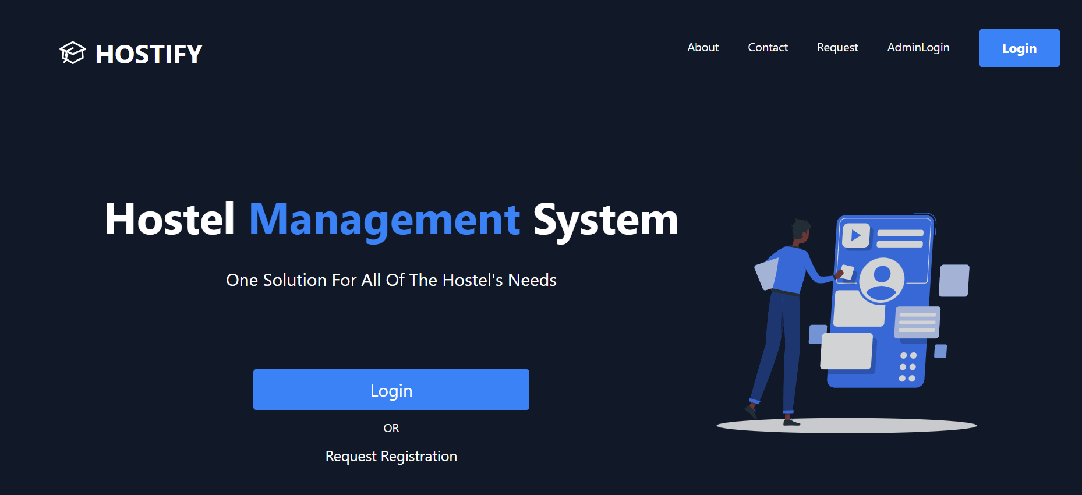
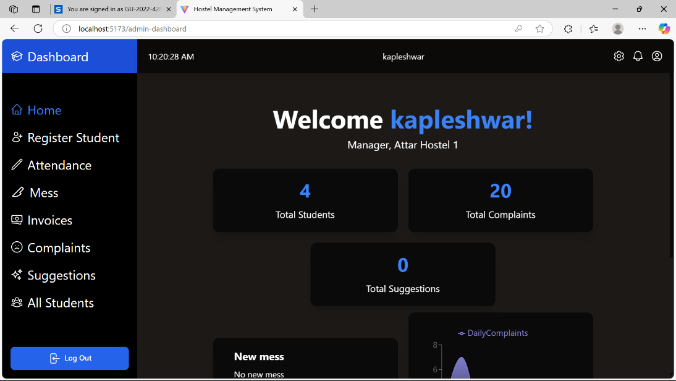
Screenshots
Frontend

Slide 8
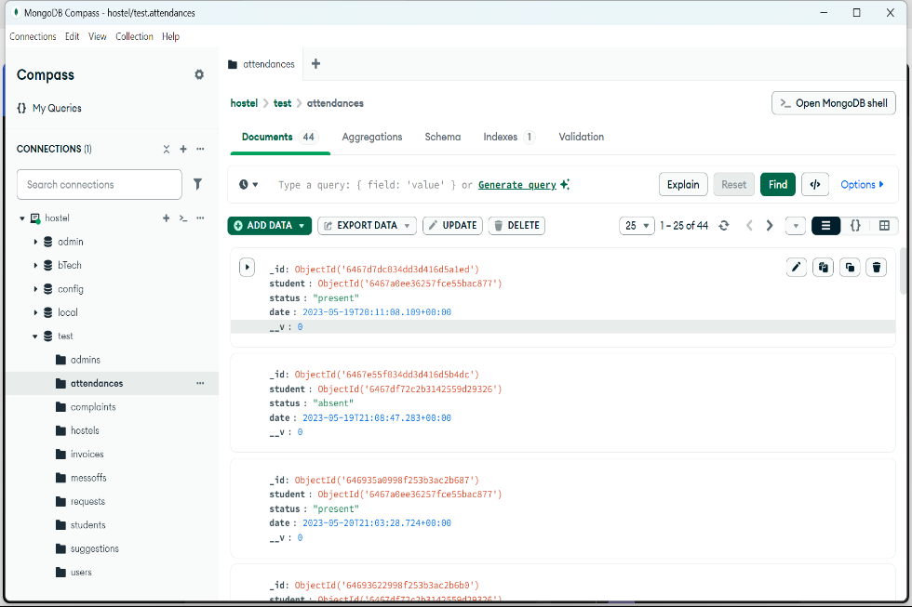
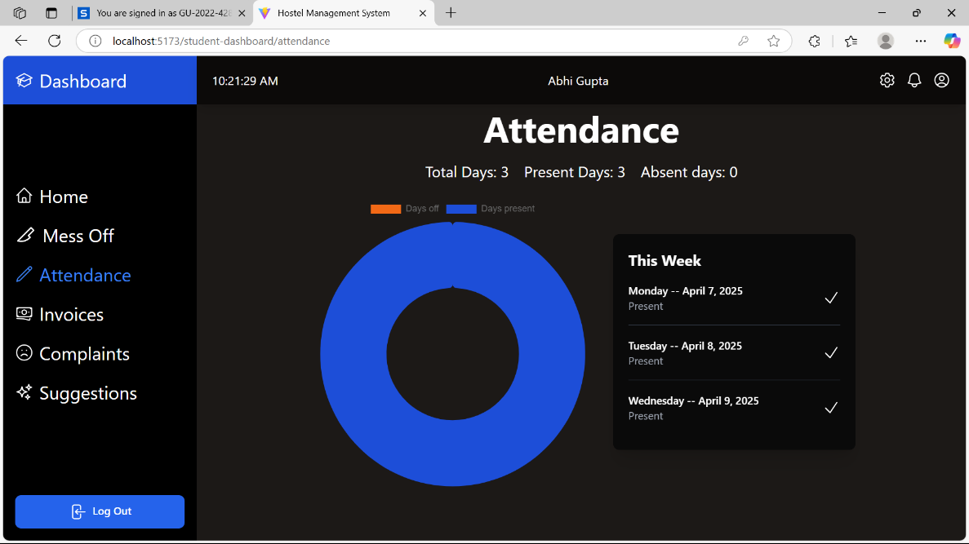
Screenshots
Backend

Slide 9
Conclusion
In conclusion, the Hostel Management System provides a modern and efficient solution for managing hostel operations digitally. By leveraging the MERN stack along with Vite and React, the system ensures fast performance, smooth user experience, and scalability. It reduces manual workload for hostel administrators by automating core tasks such as room allotment, student record maintenance, and complaint handling. At the same time, it enhances transparency and convenience for students by giving them easy access to their hostel-related information. This project not only demonstrates strong technical implementation using popular web technologies but also addresses a real-world need with practical features and user-friendly design.

Slide 10
Future scope
We can launch it as an app in the future
Echanced AI and Machine Learning Algorithms
Sustainability Features
Advanced Data Analytics
Integration with Other Services

Slide 11
THANK-YOU
Support:
Name: Kapleshwar Kumar ,Paras
Email-id:kapleshwarkumar0014@gmail.com , enquires4parassharma@gmail.com
Region: India
Location: Phagwara

